Slide 1

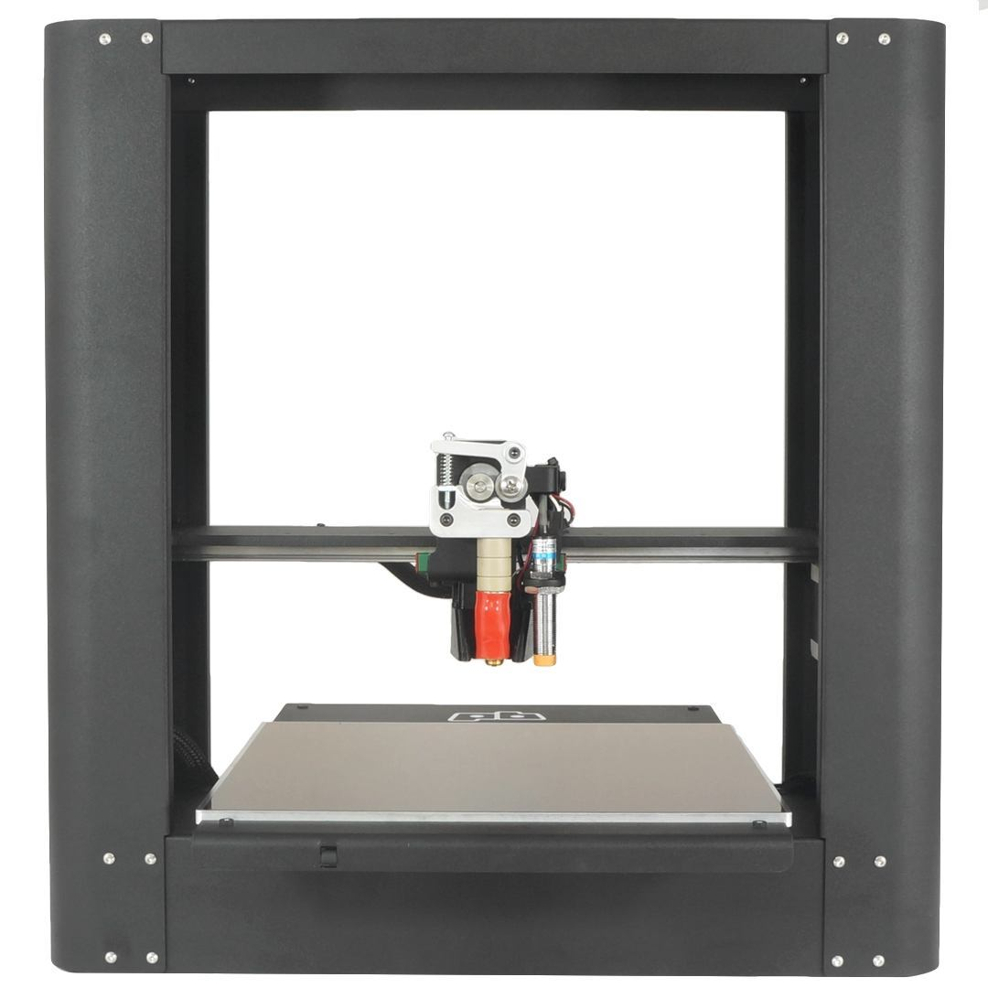
Printrbot Plus
model 1504
Unboxing Guide

Slide 2

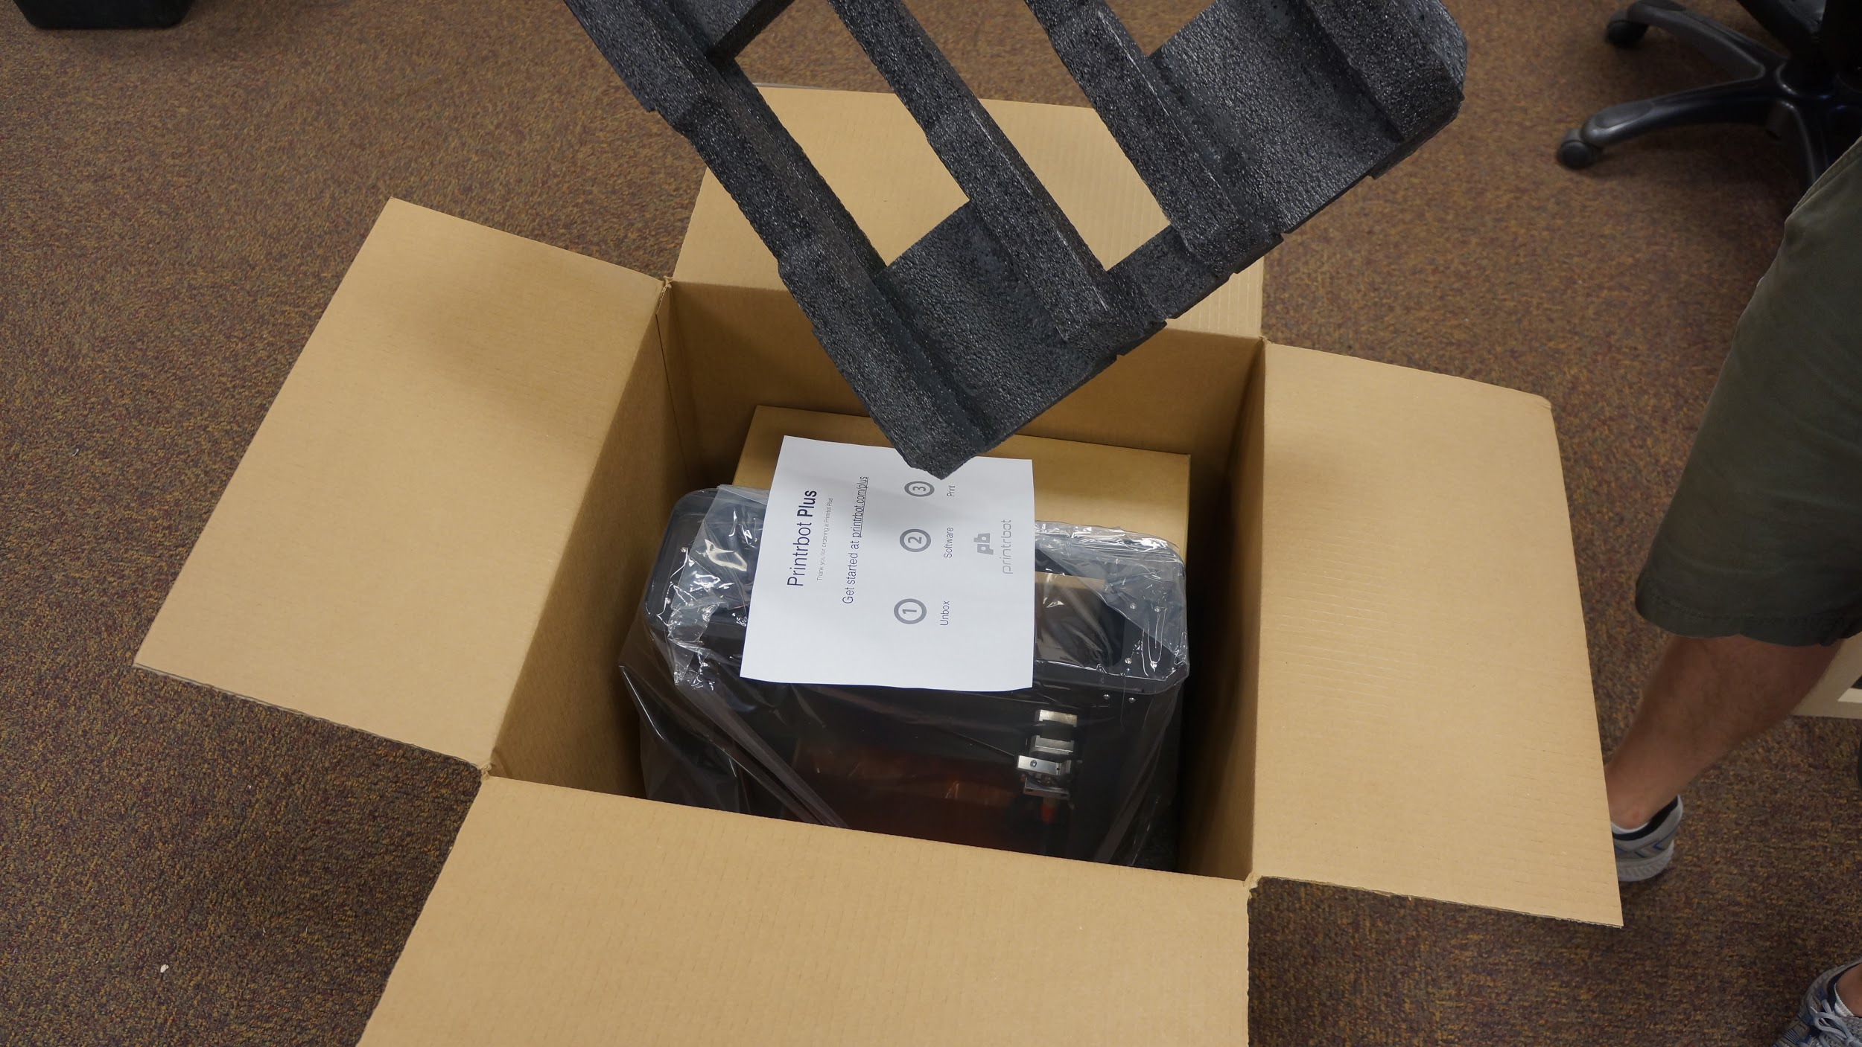
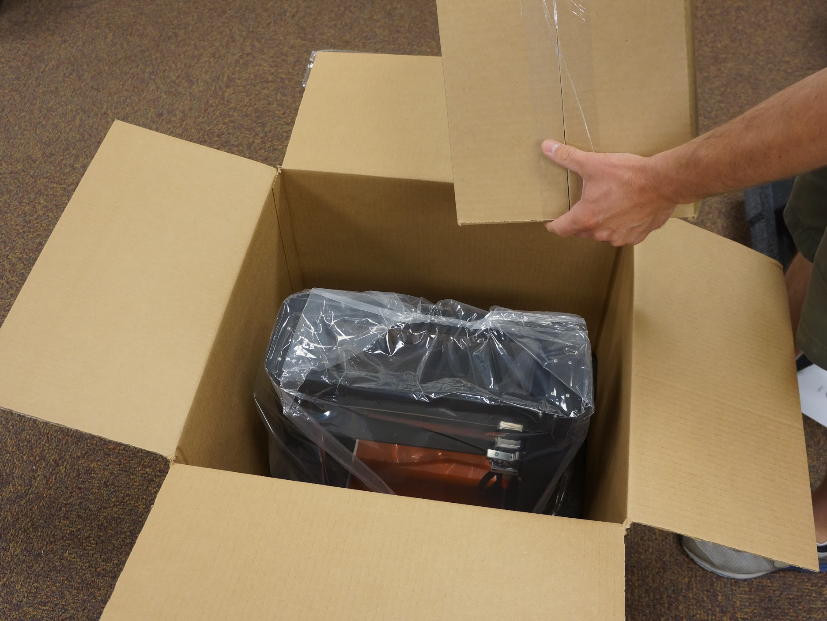
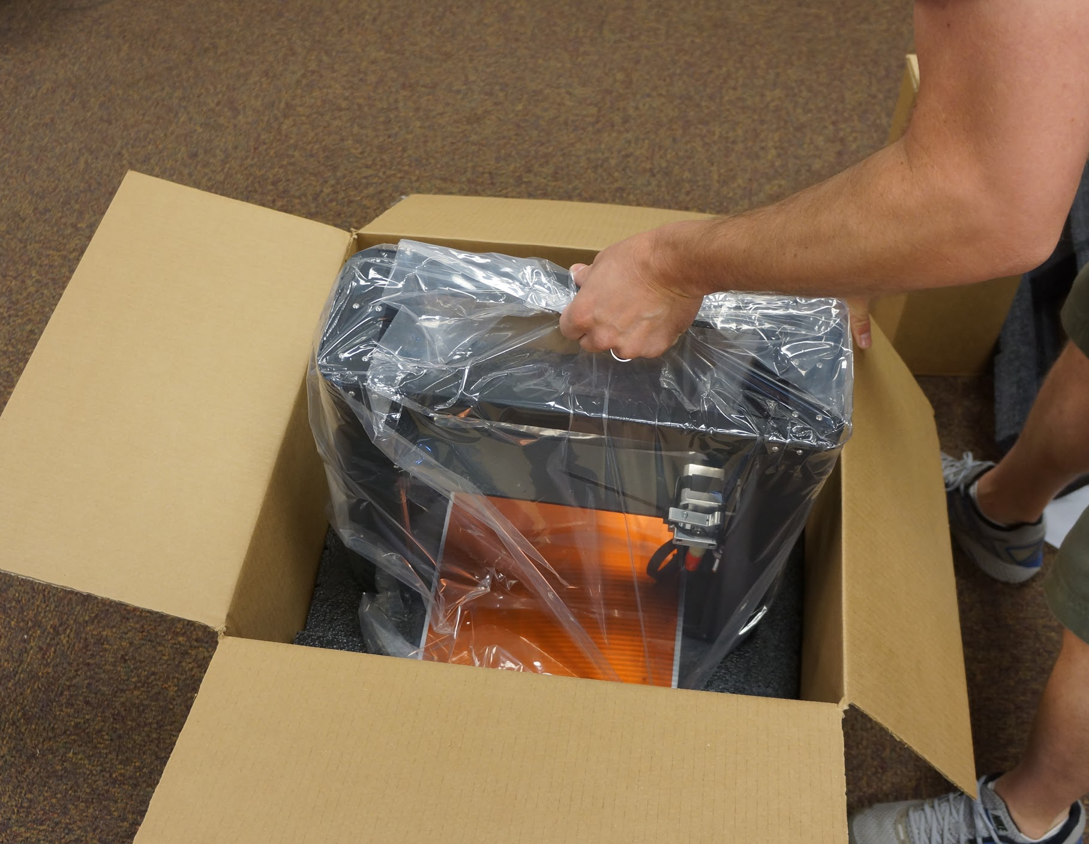
Remove Accessory Box
Remove the packing foam and take the accessory box out before removing your Printrbot Plus.
Pull the bot out by grabbing the top base bar. The Printrbot Plus weighs over 30lbs. So, you may want to grab a friend to help.

Slide 3
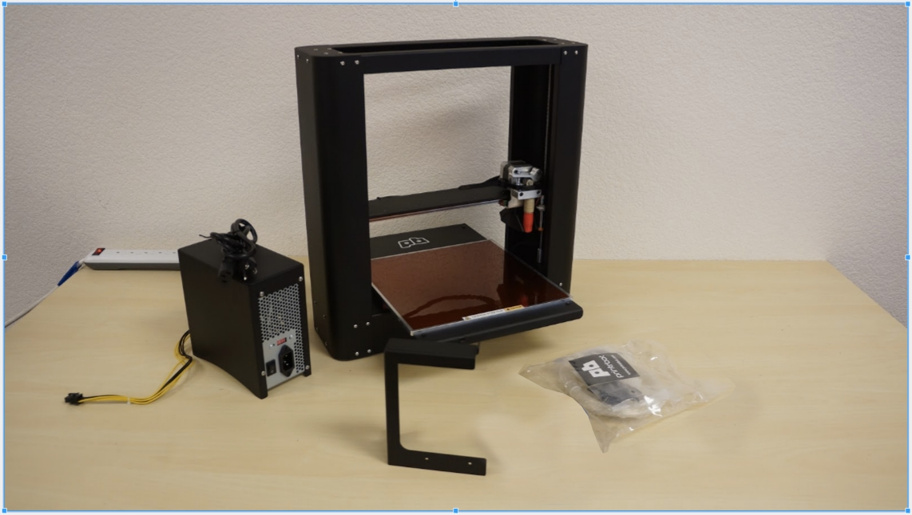
Accessories
Set your Printrbot Plus on a table and remove the poly bag.
Inside the accessory box, find the following:
Power Tower
Spool rack
Accessory bag -
Sample PLA filament
MicroUSB cable
Allen wrenches (2mm & 2.5mm)
1mm delrin spacer

Slide 4
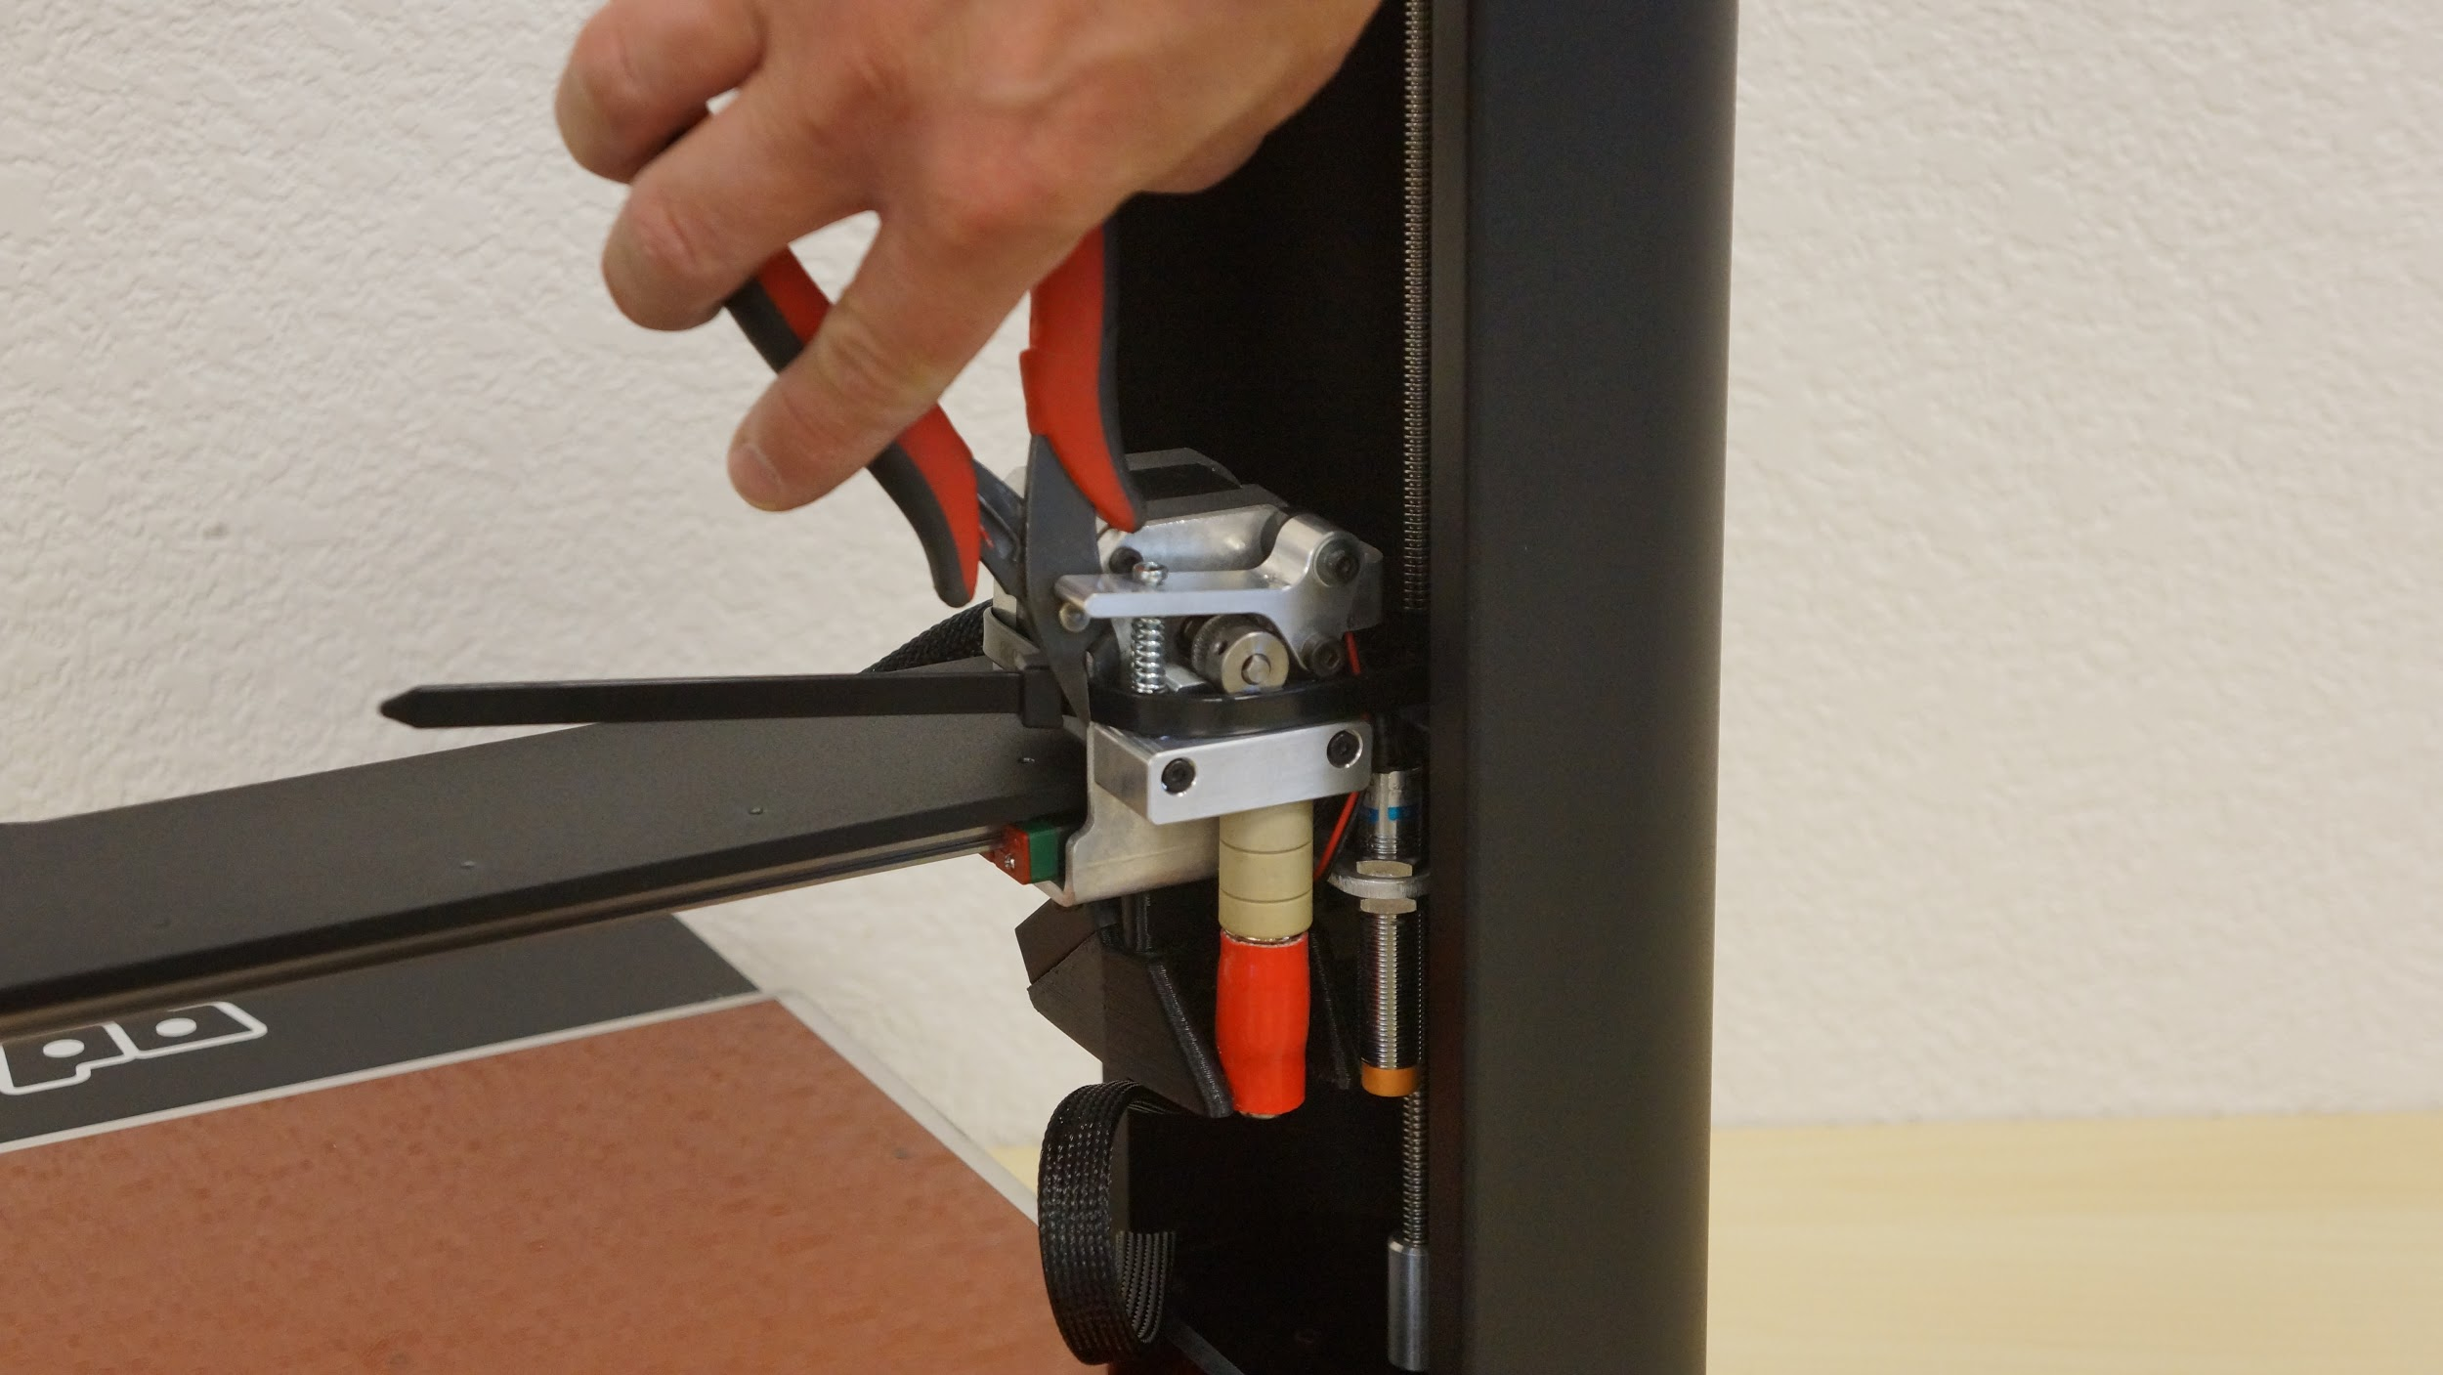
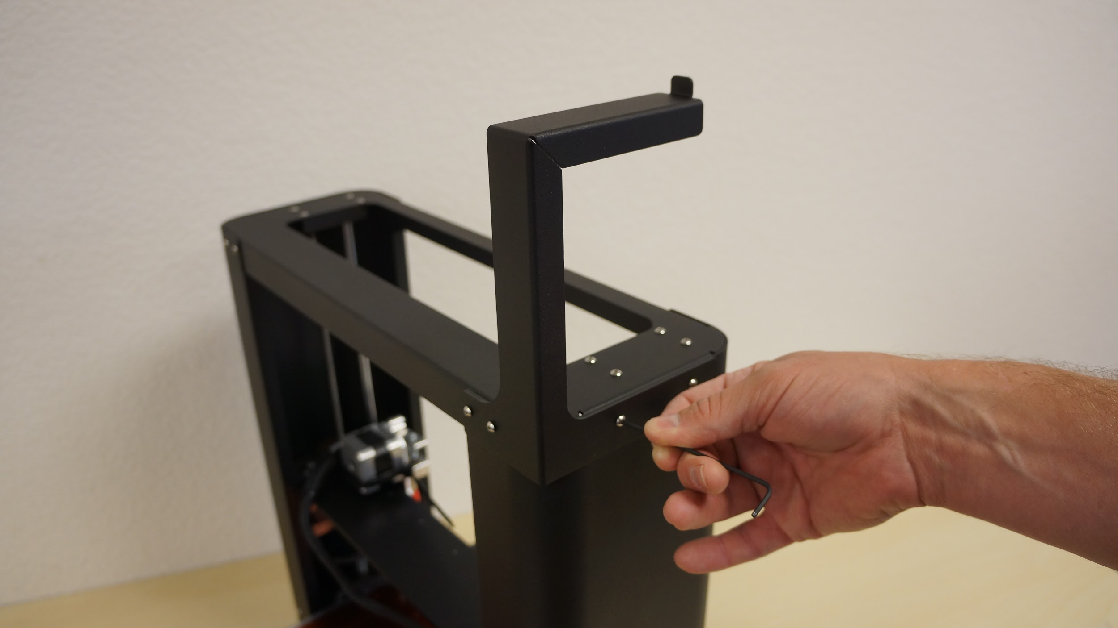
Free Extruder and Mount Spool Rack
Cut the packing zip tie to free the extruder/X carriage.
Use the 2mm allen wrench (included) to remove four button head screws from the top of the base. Use these same button head screws to mount the spool rack.

Slide 5
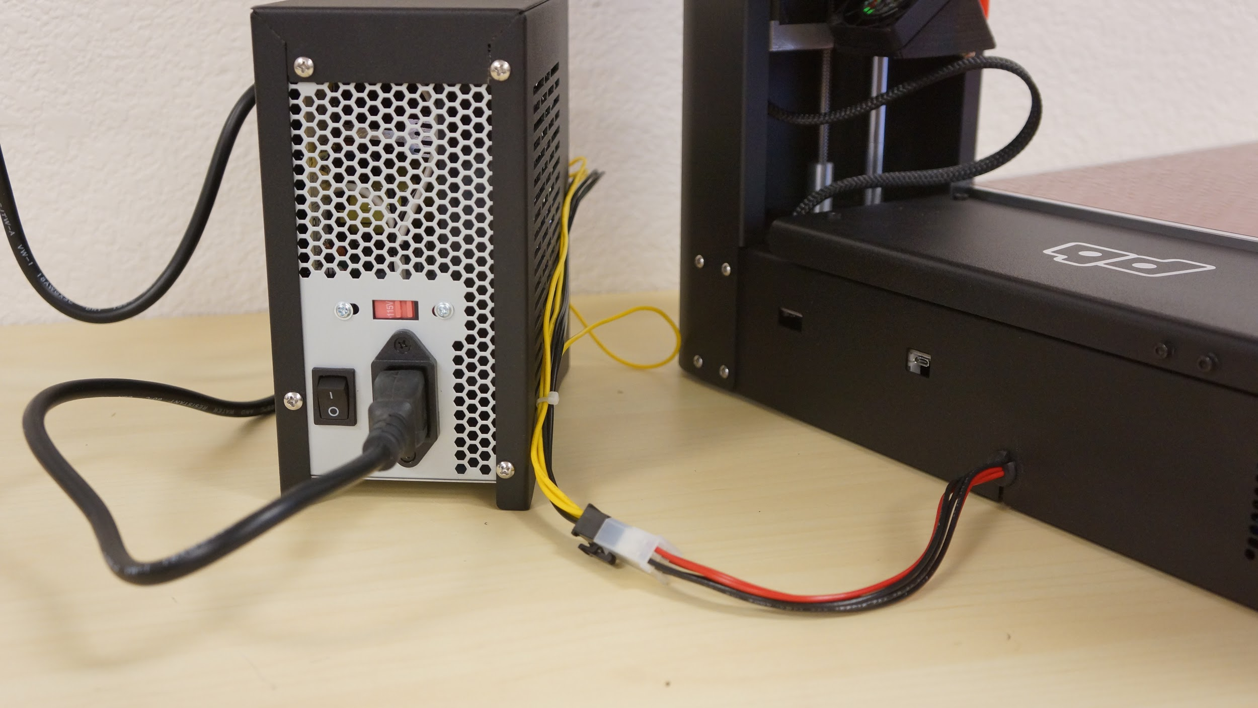
Power Tower
Connect the power cable to the ATX power supply inside of the Power Tower.
IMPORTANT
US users: Set to 115V
EU users: Set to 230V
Ignoring this will damage your power supply.
Plug the 6 pin connector into the power extension coming from the bot.

Slide 6
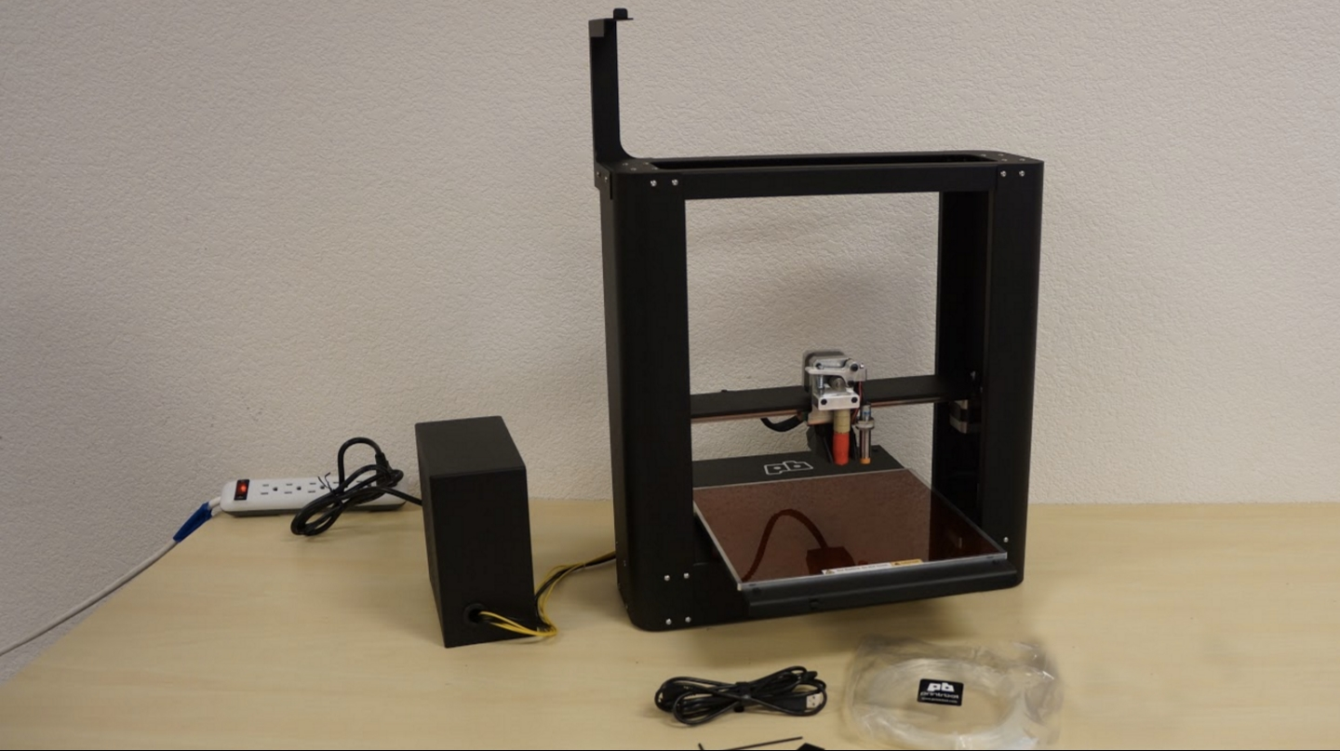
Unbox Complete!
NEXT STEPS:
Missing anything? Please contact us at support.printrbot.com.
Visit printrbot.com/plus to access the required downloads.
Move on to the next getting started guide, “Your First Print” (video).
To maintain your Printrbot, we recommend greasing the Y axis rails every 1-2 months. Tri-Flow Superior Lubricant is a satisfactory product for this.
*TIP: Turn off “sleep” settings on your computer before you begin printing.

